Slide 1
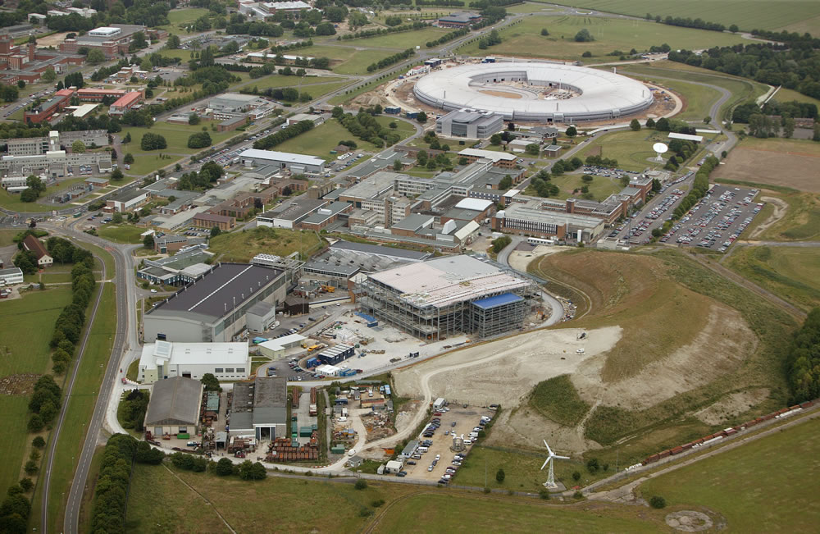
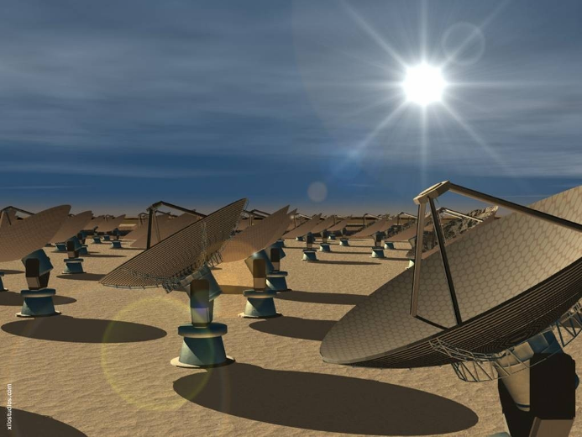
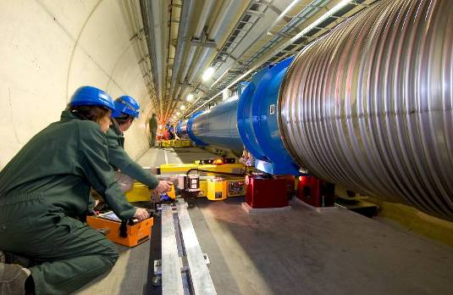
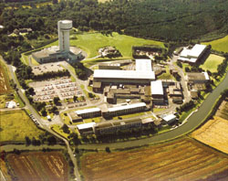
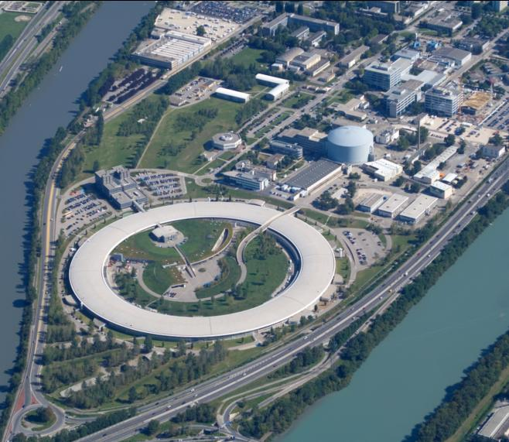
The Science and Technology Facilities Council STFC
Programme includes:
Neutron and Muon Source
Synchrotron Radiation Source
Lasers
Space Science
Particle Physics
Compuing and Data Management
Microstructures
Nuclear Physics
Radio Communications
250m
Square Kilometre Array
Large Hadron Collider
Daresbury Laboratory
ESRF & ILL, Grenoble

Slide 2
RCUK Principles on Data:
Data are a Public Good
Data should be managed
Data should be discoverable
There may be constraints
Originators may have first use
Reusers have responsibilities
Data sharing is not free
Public Good
The Data
Intellectual Property
Recognition
Access
Constraints
Discoverability
First Use
Management
PaNdata – Photon and Neutron Open Data Infrastructure
The Research Data Alliance

